Slide 1
AIML CA2
Time Series
& Unsupervised Learning
By Ashley Bai (P2237871, DAAAFT2A04)

Slide 2
01
Time Series (Part A)
Use Energy Consumption Dataset to build and train time series models and forecast the gas, electricity, and water consumptions
in the future.

Slide 3
TABLE OF CONTENTS
01
02
03
04
05
EDA
DATA PRE-PROCESSING
ANALYSIS OF TIME SERIES
BUILD MODELS AND EVALUATION
FORECAST
FUTURE

Slide 4
01
Exploratory Data Analysis (EDA)

Slide 5
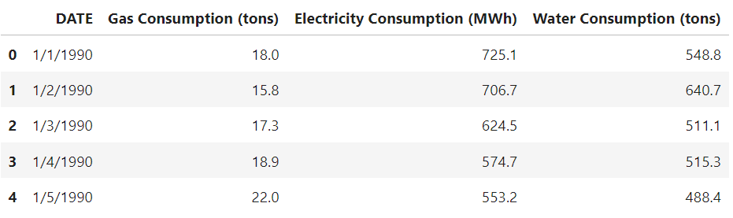
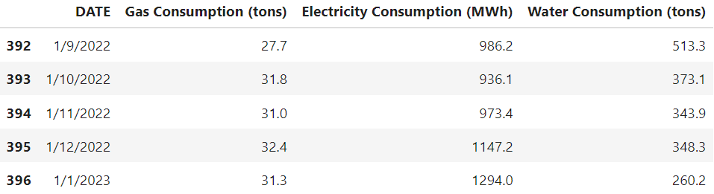
Exploratory Data Analysis (EDA)
Contains numerical and categorical (DATE) variables.
The DATE column is not the index.
The DATE column is of DD/MM/YYYY format.
Data is arranged in chronological order.
Starting date: 1/1/1990.
Ending date: 1/1/2023.
397 rows and 4 columns.
No null, missing, or duplicated values.
Presence of outliers in the Gas Consumption (tons) and Water Consumption (tons) columns.

Slide 6
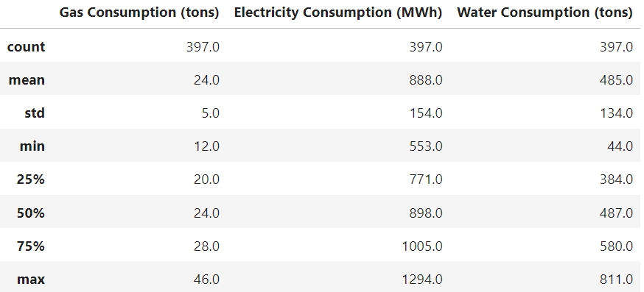
Exploratory Data Analysis (EDA)
On average, 24 tons of gas, 888 MWh of electricity, and 485 tons of water is consumed.
The median of Gas Consumption and Water Consumption do not differ much from the mean, suggesting normal distributions.
The median of Electricity Consumption differs most from the mean, indicating not normal distribution.

Slide 7
02
Data Pre-Processing

Slide 8
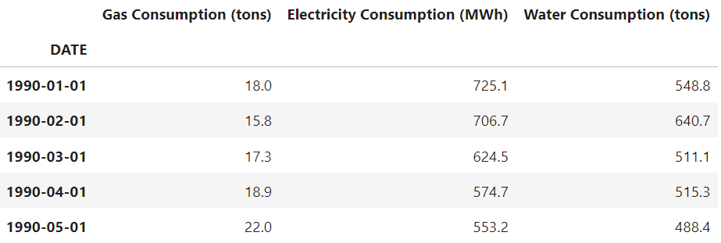
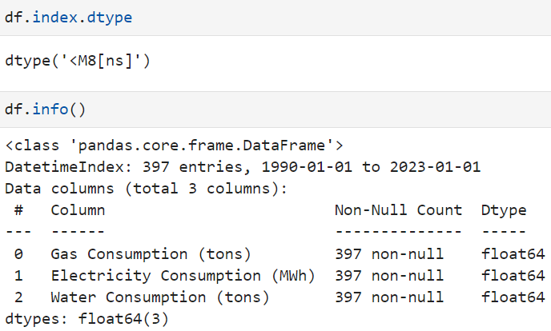
Data Pre-Processing
Handling categorical DATE variable:
Converted the data type to datetime, with format of ‘%d/%m/%Y’.
Created time series index.
All variables are now suitable for forecasting.

Slide 9
03
Time Series Analysis

Slide 10
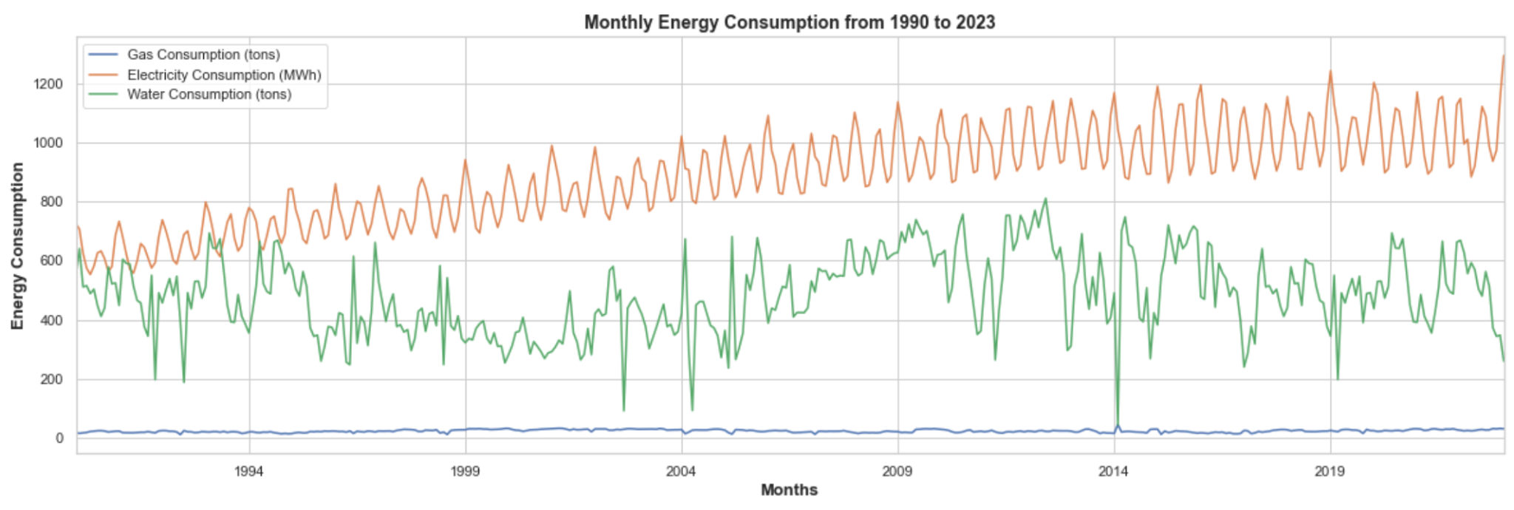
Analyzing Time Series Data

Slide 11
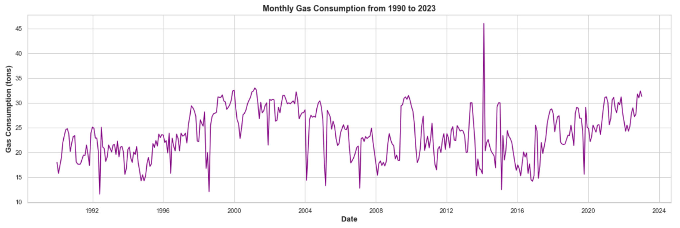
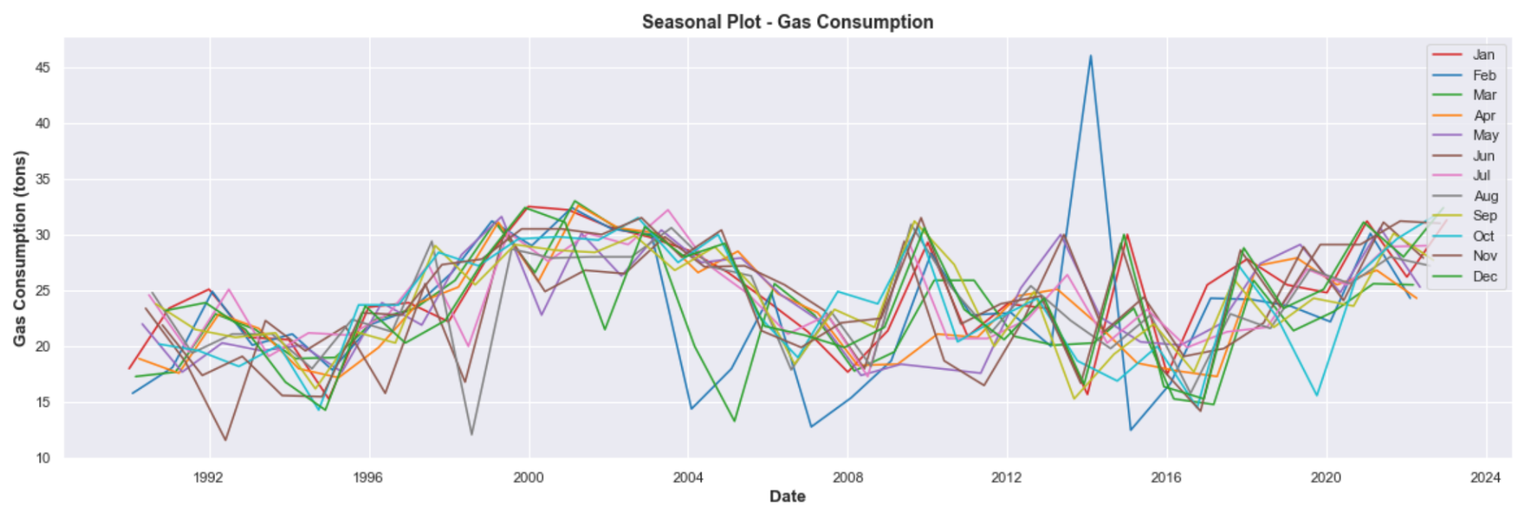
Analyzing Gas Consumption
1. Line Plot
2. Seasonal Plot
Trend:
No clear upward or downward trend, data is fluctuating from 1990 to 2023.
Seasonality:
Seasonality is not clearly observed here.
No distinct repeating patterns of similar magnitude at regular intervals.
Outlier:
Spike observed in 2014 (more than 45 tons).
Variability:
Presence of variability is observed, random variation.
There could be a possibility of seasonality, although not much distinct pattern due to the spike in 2014 february.
Need to do further visualizations to back this up.

Slide 12
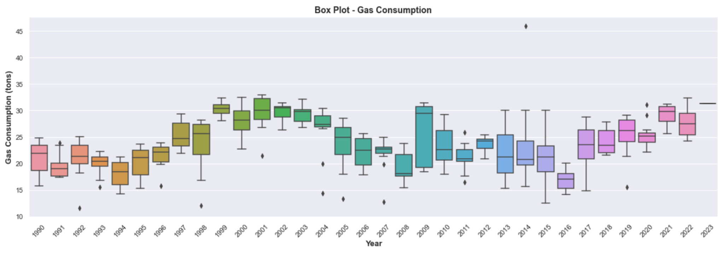
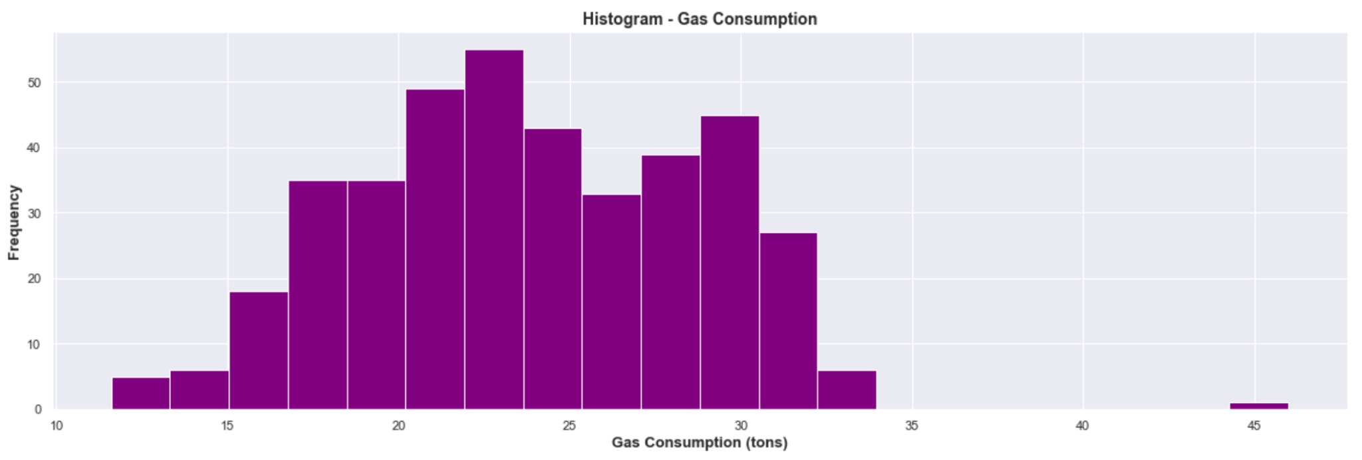
Analyzing Gas Consumption
3. Box Plot
4. Histogram
We can observe variations in gas consumption from 1990 to 2023, as evident in the differing heights of the boxplots.
The wider boxes indicate increased variability in consumption, suggesting fluctuations in gas consumption.
There are a few outliers for various years, potentially indicating unique events or circumstances.
Right-skewed distribution (positively-skewed), with majority of values clustered towards the lower end of consumption.
Most instances observe relatively lower gas consumption levels.
There is an outlier bin of 45 tons.
The minority instance of higher gas consumption levels could be due to specific events or circumstances.
Mean > median.
There is higher variability.

Slide 13
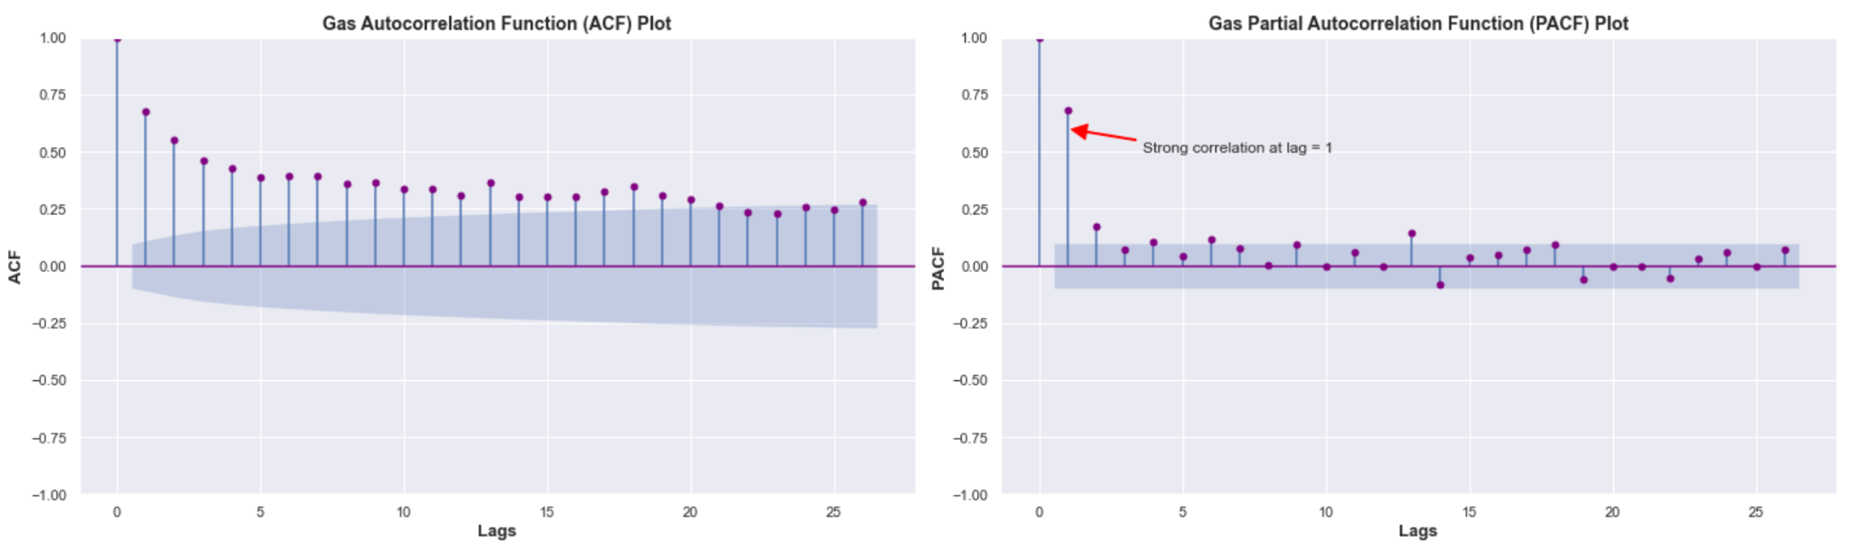
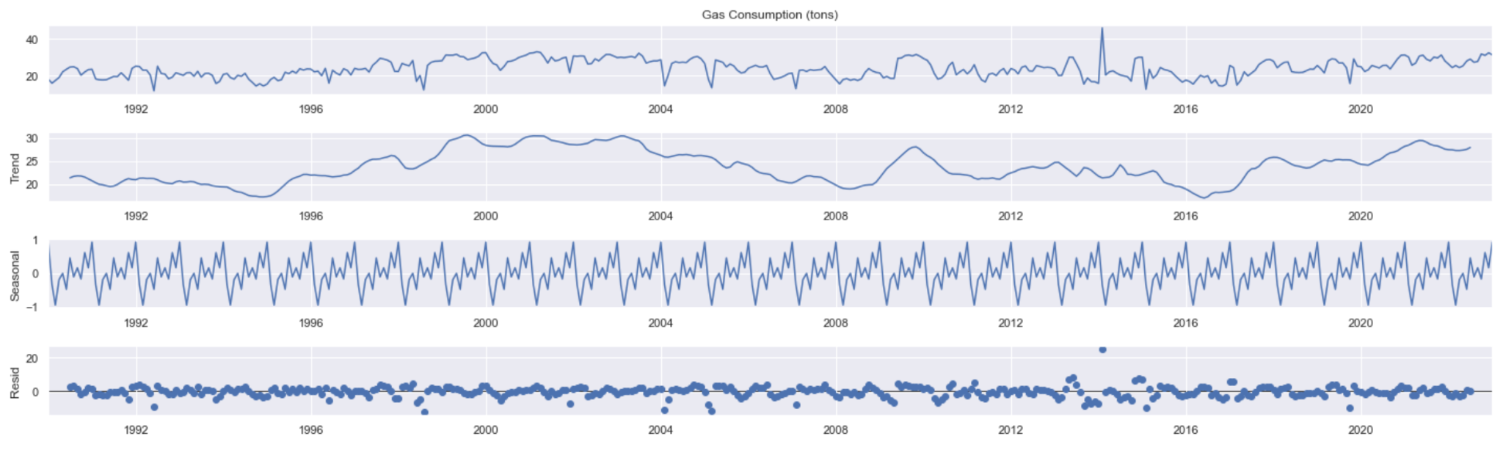
Analyzing Gas Consumption
5. ACF and PACF Plot
6. Decomposition Plot
The ACF plot displays the correlation between the time series at a specific lag and the time series at lag 0 (itself).
The ACF values is seen to decay slowly, indicating possible presence of trend/seasonality.
The PACF plot focuses on the direct relationship between 2 data points while accounting for the influence of the intervening lags.
In the plot, there is a spike at lag 1, and then gradually decreases with no other significant spikes, suggesting an AR(1) process.
Trend:
No trend.
Seasonality:
Regular fluctuations that repeat over time, indicating presence of seasonality.
The seasonality might indicate higher consumption during certain months, like colder months leading to increased heating demand.
Residuals:
The residuals exhibit fluctuations around zero, suggesting that most of the systematic patterns have been captured by the trend and seasonality components.

Slide 14
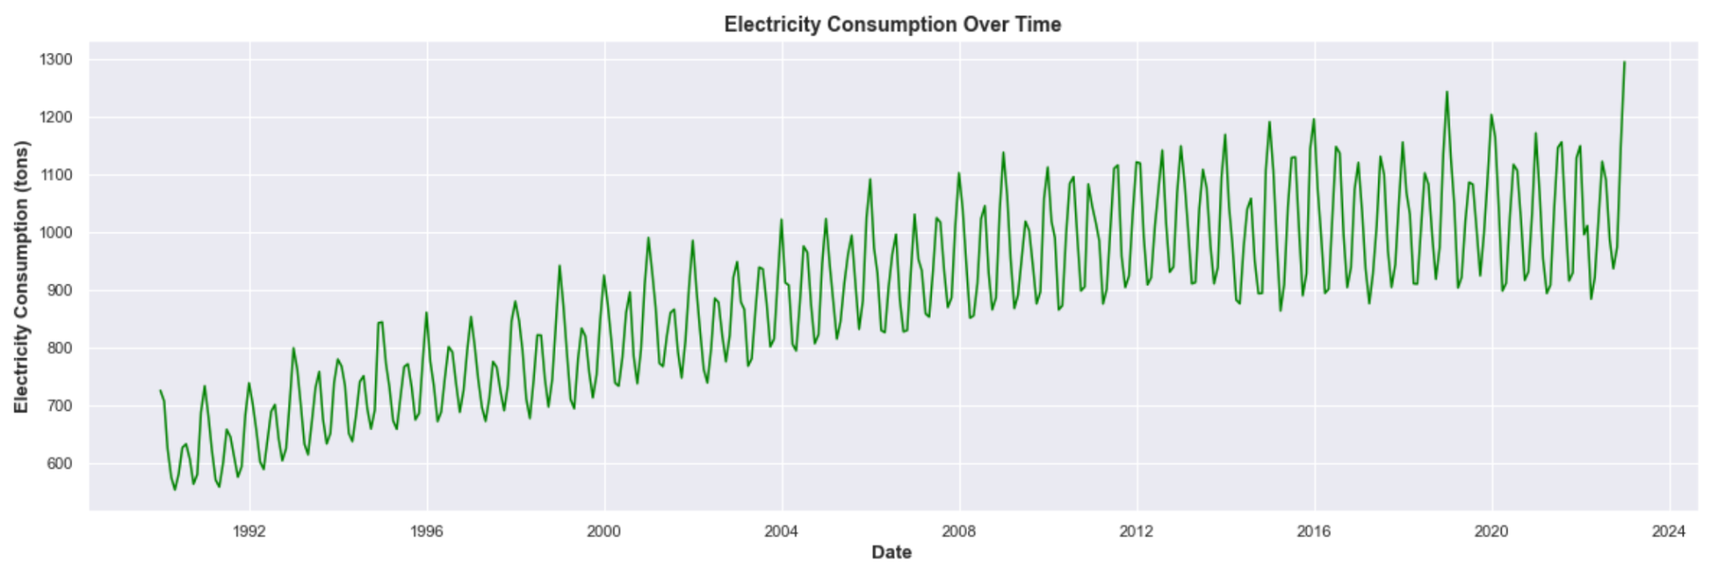
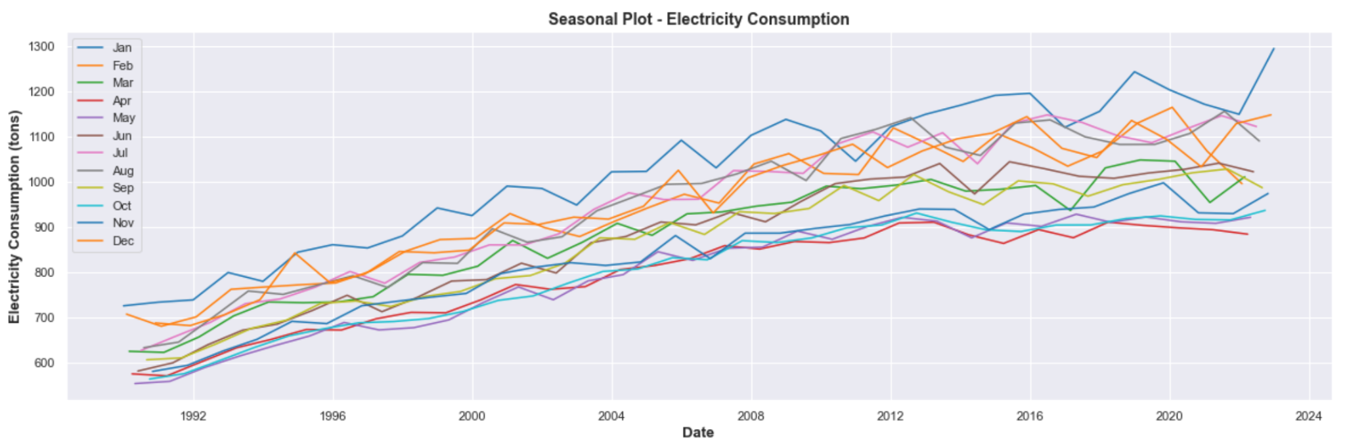
Analyzing Electricity Consumption
1. Line Plot
2. Seasonal Plot
Trend:
Clear upward trend, indicating an increase in electricity consumption from 1990 to 2023.
Seasonality:
Seasonality is observed, as there are repeating patterns of similar magnitude at regular intervals, moving in an upward trend.
Outlier:
No outlier/extreme points observed.
Variability:
Presence of both short-term fluctuations and longer-term trends.
The variability is moderate as spread of data points around / is decent.
The plot shows a recurring pattern that recurs across each year, in an upward direction.
Cyclic patterns are observed -> seasonality
The plot's consistent peaks and troughs suggest a consistent monthly cycle in electricity consumption.
Notably, the months of December, January, February stand out as periods of elevated consumption, potentially associated with cooler weather and increased demand for heating systems and appliances.
Spring months have decent electricity consumption levels.

Slide 15
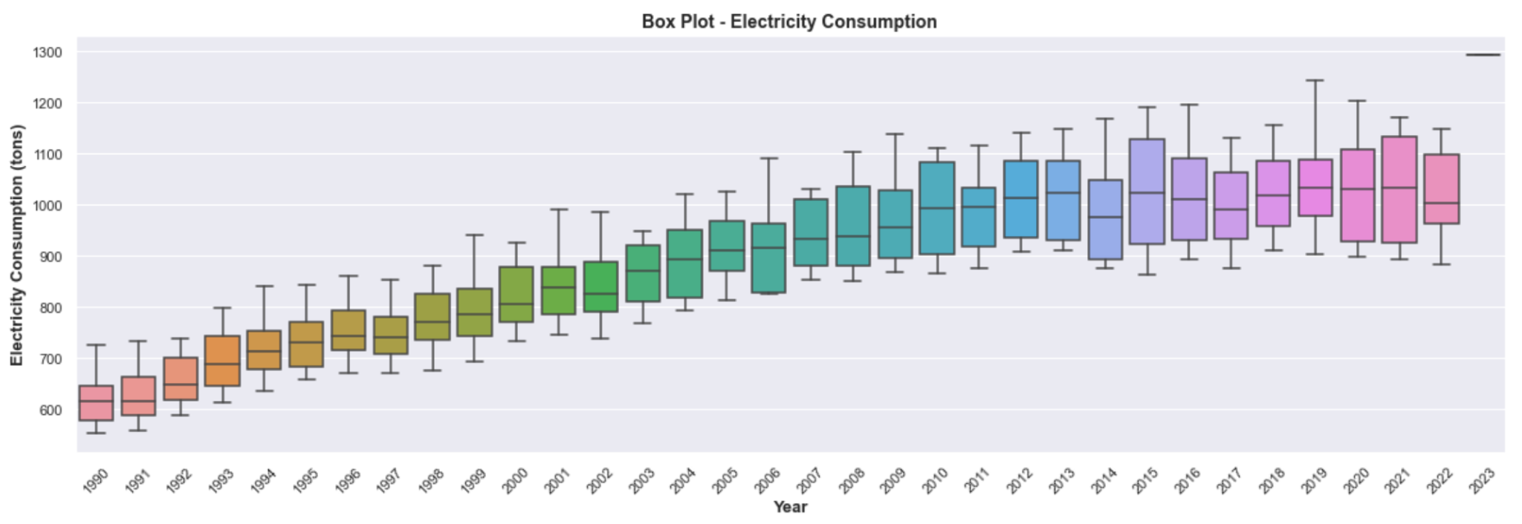
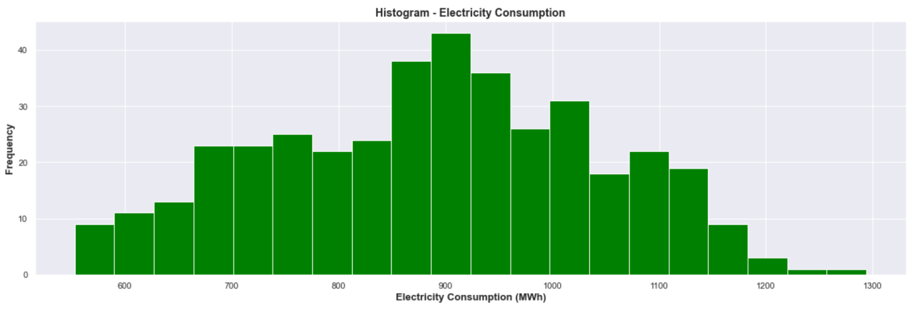
Analyzing Electricity Consumption
3. Box Plot
4. Histogram
Variation of electricity consumption levels seem to increase over the years.
There is a relatively consistent pattern, where the fluctuations of heights of box plots seem to be quite consistent.
There are no outliers.
Symmetric distribution (normal), with majority of values clustered towards the lower end of consumption, indicating a balanced distribution of electricity consumption levels.
Most common electricity consumption value seems to be 900 MWh.
Mean = median.

Slide 16
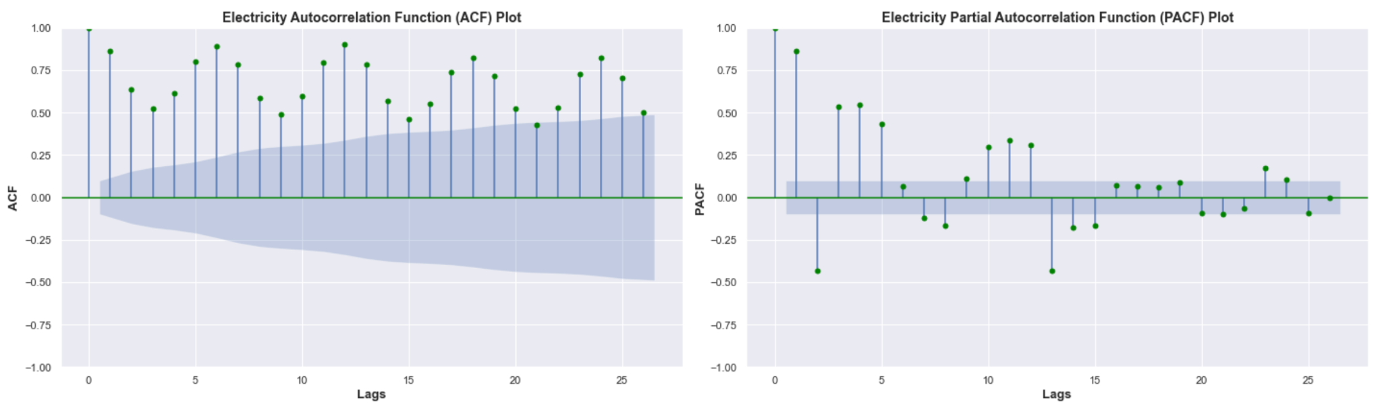
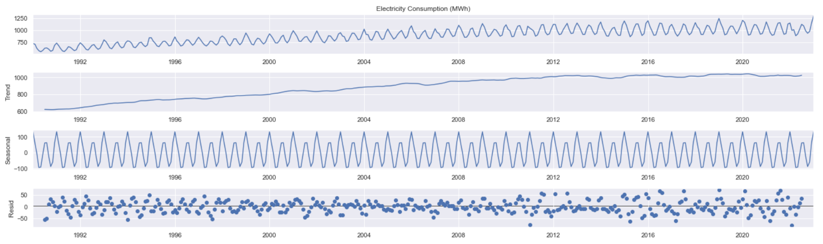
Analyzing Electricity Consumption
5. ACF and PACF Plot
6. Decomposition Plot
Indicates non-stationarity.
Trend:
Overall increasing consumption of electricity, possibly due to various external factors like weather changes or changing consumer behavior.
Seasonality:
Regular fluctuations that repeat over time, indicating presence of seasonality.
The seasonality might indicate higher consumption during certain months, like colder months leading to increased heating demand.
Residuals:
The residuals exhibit fluctuations around zero, suggesting that most of the systematic patterns have been captured by the trend and seasonality components.
Larger spikes in the residual component might indicate periods where the observed data deviates from the trend and seasonality.

Slide 17
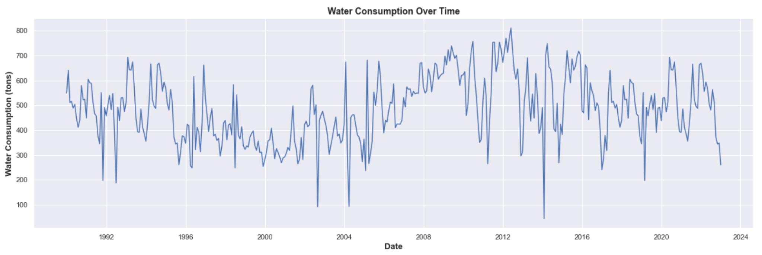
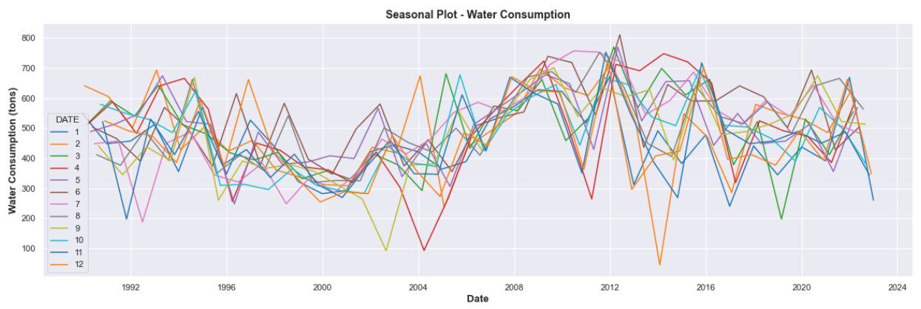
Analyzing Water Consumption
1. Line Plot
2. Seasonal Plot
Trend:
No clear upward or downward trend, data is fluctuating from 1990 to 2023.
Seasonality:
Seasonality is not clearly observed here.
No distinct repeating patterns of similar magnitude at regular intervals.
Variability:
Presence of variability is observed, random variation.
There could be a possibility of seasonality, although not much distinct pattern due to the spike in 2014 february.
Need to do further visualizations to back this up.

Slide 18
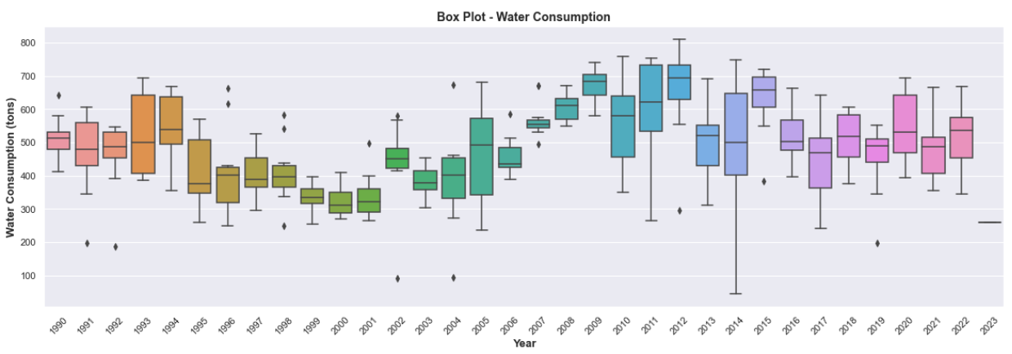
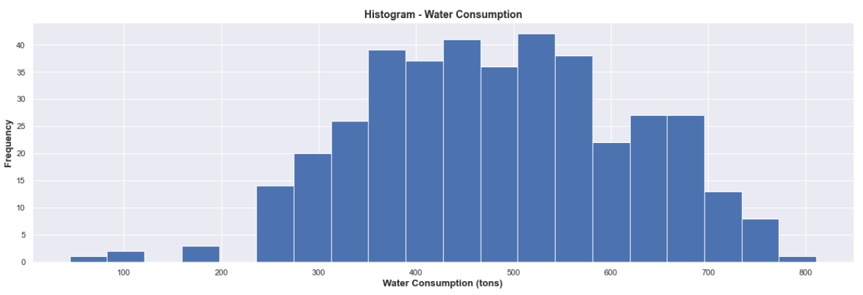
Analyzing Water Consumption
3. Box Plot
4. Histogram
We can observe variations in water consumption from 1990 to 2023, as evident in the differing heights of the boxplots.
There are a few outliers for various years, potentially indicating unique events or circumstances.
Fluctuating pattern is observed over the years.
Right-skewed distribution (positively-skewed), with majority of values clustered towards the lower end of consumption.
Most instances observe relatively lower water consumption levels.
Greatest is more than 500 tons (many large instances)
Mean > median.
There is higher variability.

Slide 19
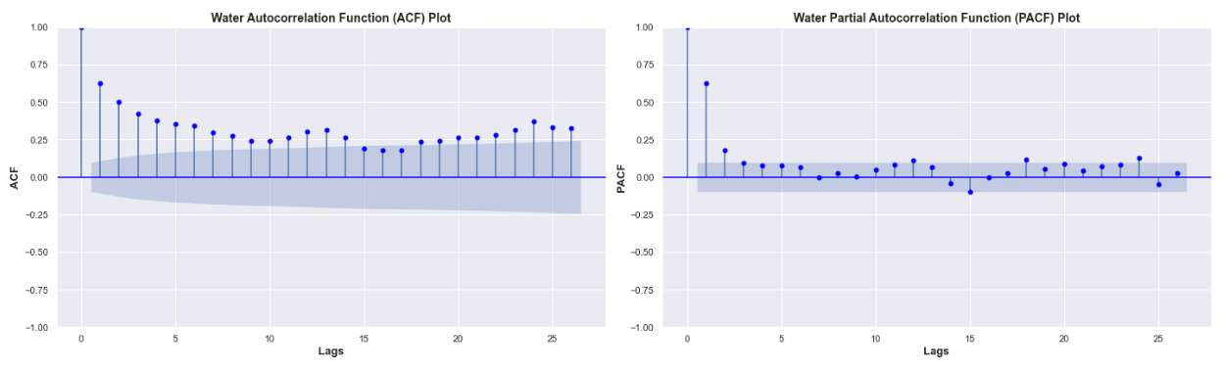
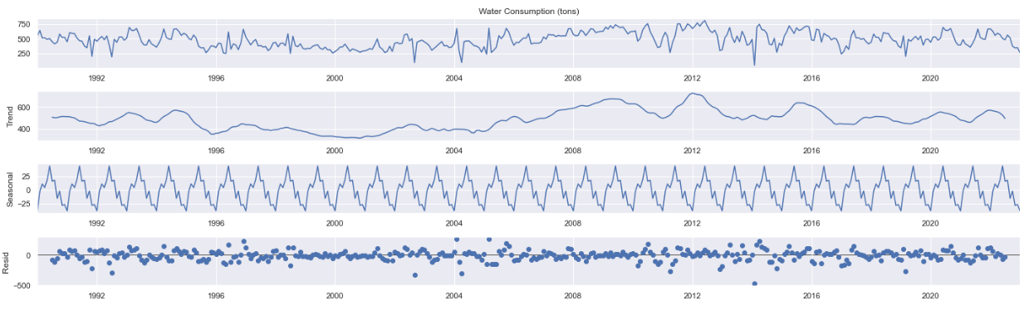
Analyzing Water Consumption
5. ACF and PACF Plot
6. Decomposition Plot
ACF plot:
The ACF plot displays the correlation between the time series at a specific lag and the time series at lag 0 (itself).
The ACF values is seen to decay slowly, thereafter fluctuating consistently.
PACF plot:
The PACF plot focuses on the direct relationship between 2 data points while accounting for the influence of the intervening lags.
In the plot, there is a spike at lag 1, and then gradually decreases with no other significant spikes, suggesting an AR(1) process.
Trend:
No trend, fluctuations.
Seasonality:
Regular fluctuations that repeat over time, indicating presence of seasonality.
Residuals:
The residuals exhibit fluctuations around zero, suggesting that most of the systematic patterns have been captured by the trend and seasonality components.
Larger spikes in the residual component might indicate periods where the observed data deviates from the trend and seasonality.

Slide 20
Checking Stationarity
25%
50%
75%
Time series is stationary if it has constant mean, variance, and covariance.
1. Graphical Check
2. Basic Statistics
3. ADF Test
Analyze trends and seasonality from the graphs
Split time series and compare the mean and variance of groups
Analyze test statistics
and P-values

Slide 21
Checking Stationarity
25%
1. Graphical Check
Line Plot:
- Gas and water has no obvious trends or patterns, indicating stationarity.
- Electricity has an increasing trend, indicating possibility of non-stationarity.
Seasonal Plot:
- All three shows possibility of seasonality, need to do further visualizations.
Autocorrelation Plot (ACF):
- Gas and water's ACF values shows trend of decaying to zero direction, indicating stationarity.
- Electricity does not show any decaying trend, only fluctuations, indicating non-stationarity.
Partial Autocorrelation Plot (PACF):
- Gas and water's PACF values shows trend of decaying to zero direction, indicating stationarity.
- Electricity does not show any decaying trend, only fluctuations, indicating non-stationarity.
Histogram:
- Interestingly, only electricity showed obvious bell-shaped curve, indicating stationarity.
Box Plot:
- Medians are closer in range for Gas and water and not for electricity.
Decomposition Plot:
- All three have residuals that fluctuate around zero without any obvious patterns, however electricity's residuals are further apart from zero.
Although it seems like only electricity shows non-stationarity, we need to do more test to prove, this alone is insufficient.

Slide 22
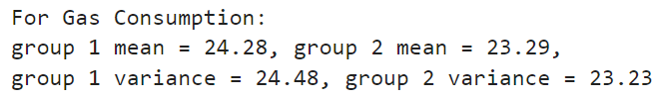
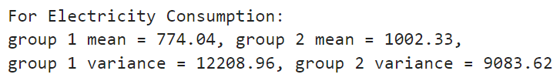
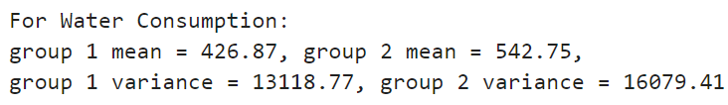
Checking Stationarity
50%
2. Basic Statistics
Stationary: same mean and same variance.
Gas Consumption seems to be stationary:
The mean and variance values in both groups are relatively close, indicating that the overall average gas consumption and variability does not exhibit a significant shift between the two periods.
Electricity and Water Consumption is not proved to be stationary:
The mean and variance values between both groups in Electricity and Water are notably different.
This difference in means indicates that there may be a significant shift or trend in the consumption over the two periods.
The difference in variances could suggest varying levels of volatility or variability in consumption.
Need further tests to confirm their stationarity.

Slide 23
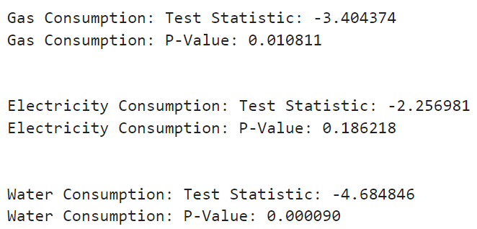
Checking Stationarity
75%
3. ADF Statistics Test
Null hypothesis: Time series can be represented by a unit root, not stationary.
P-value > 0.05: fail to reject the null hyp, data has a unit root and is non-stat.
P-value < 0.05: reject null hyp, data does not have a unit root, and is stat.
Test Statistic: a more negative (lower) TS indicates stronger evidence against
the null hypothesis of non-stationarity.
Gas Consumption:
Test statistic is quite negative and low.
The P-value < 0.05 significance level.
Appears to be stationary.
Electricity Consumption:
Test statistic is negative, but not as strongly negative as desired for
a clear indication of stationarity.
The P-value is greater than the 0.05 significance level.
Null hypothesis not rejected, appears to be non-stationary.
Water Consumption:
Test statistic is more negative than the critical values.
Very low P-value < 0.05 significance level
Strong stationarity.

Slide 24
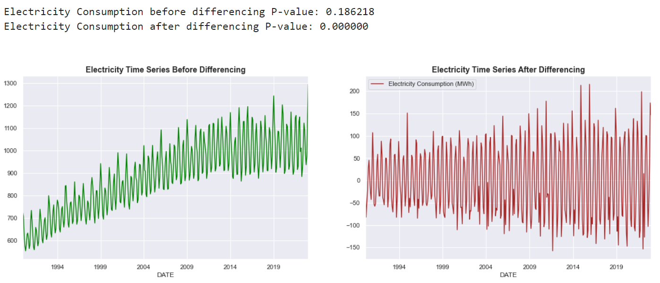
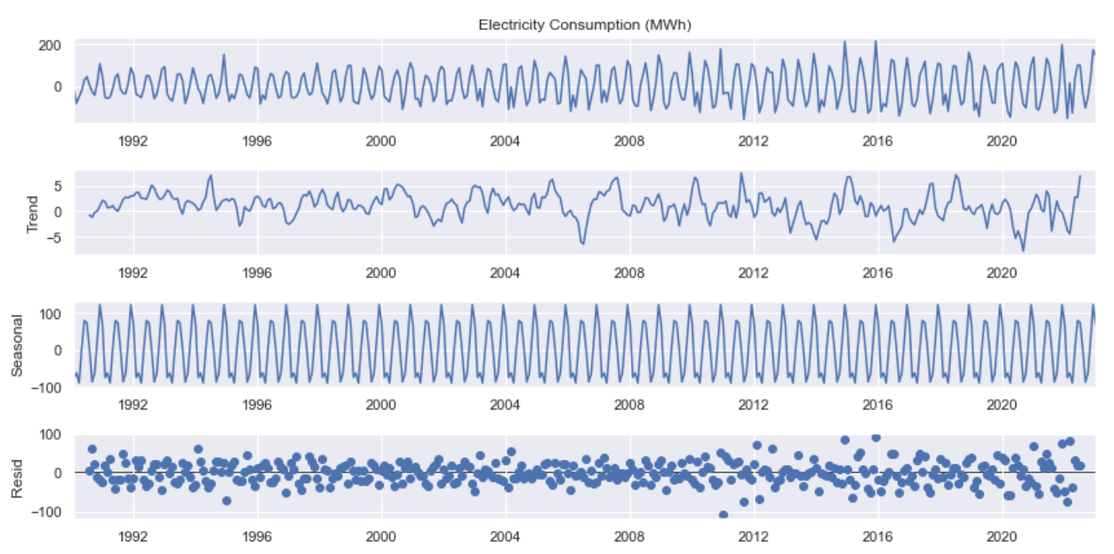
Make Electricity time series
stationary through differencing
100%
Differencing computes the difference between consecutive observations in the time series.
No more presence of trend and seasonality (weakened).
Mean, variance, and covariance of time series looks constant now.
Time series is now ready for accurate modelling and forecasting!

Slide 25
04
Build Forecasting Models and Evaluation

Slide 26
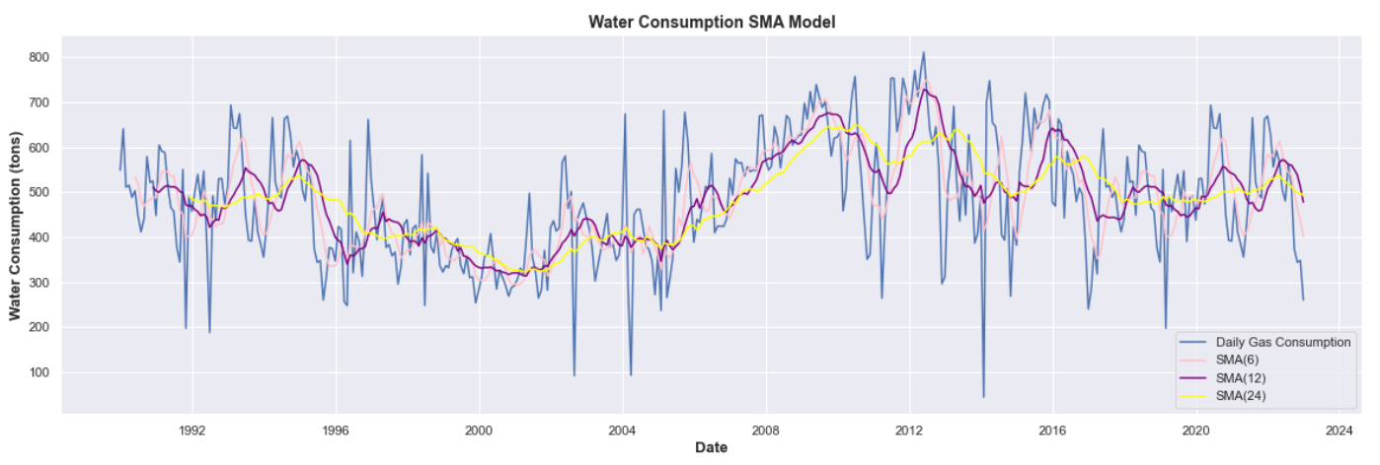
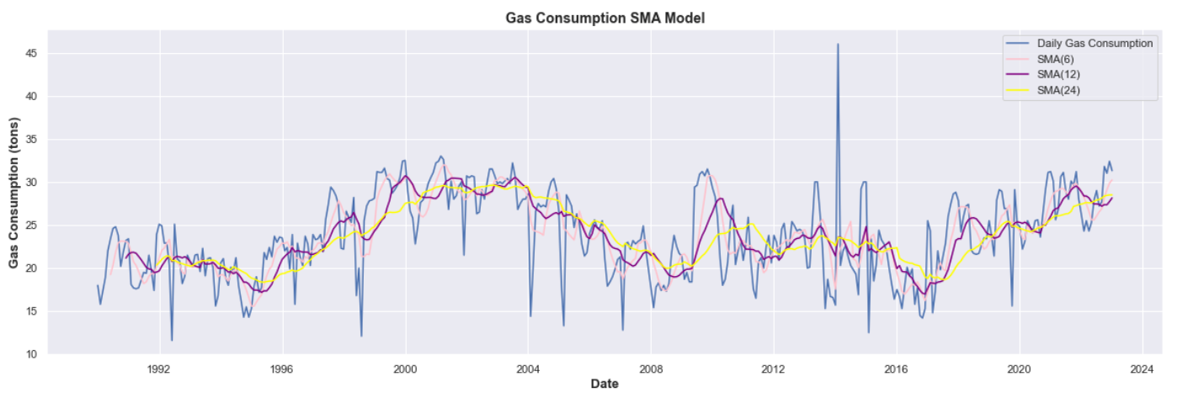
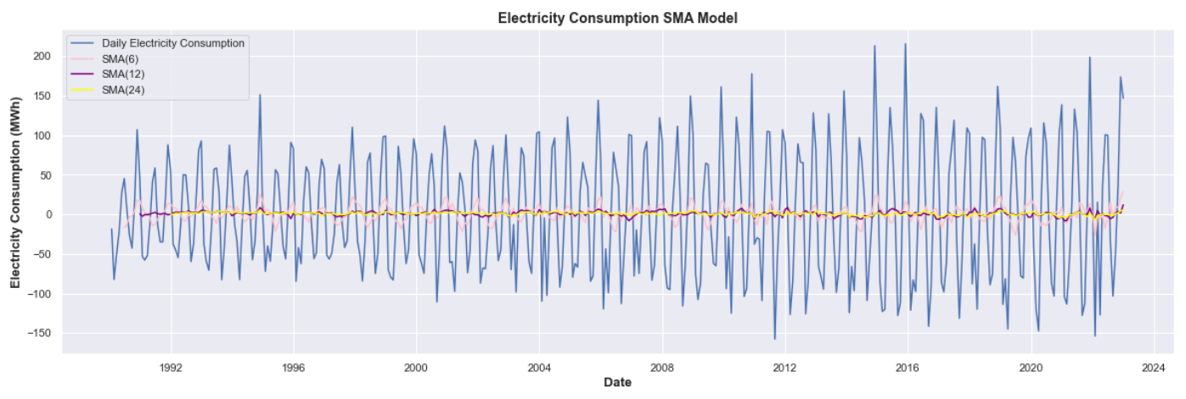
1. Simple Moving Average (Baseline)
SMA is only a baseline model which can help capture basic trends and seasonality to give a simple prediction by smoothing out fluctuations.
The larger the window, the smoother the plot.
Seasonality may be observed and there seems to be no clear trend for all.

Slide 27
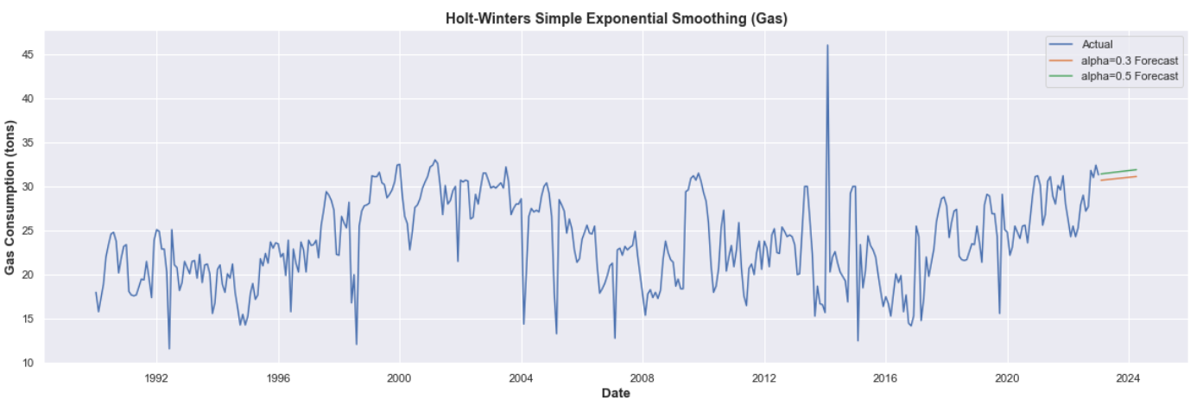
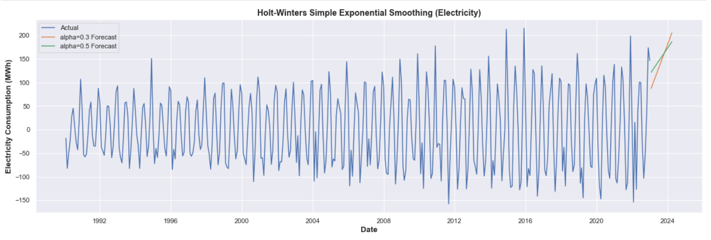
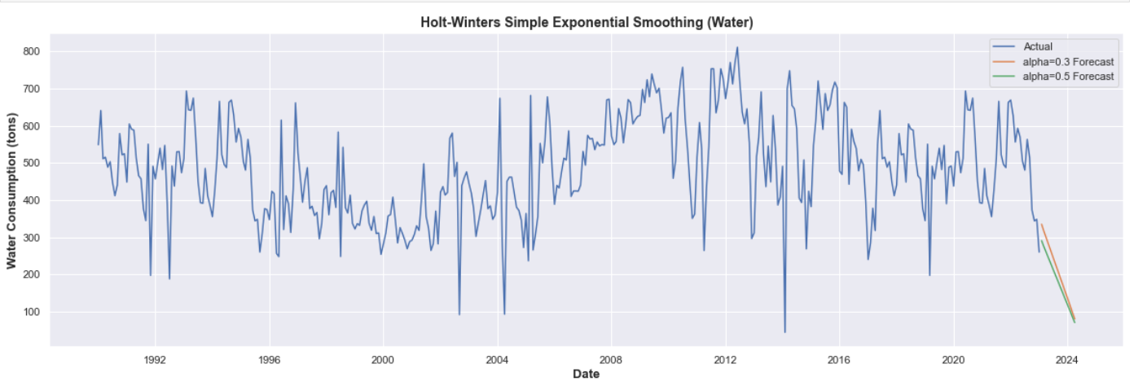
2. Simple Exponential Smoothing
The model generally predicts an increase in gas and electricity consumptions in the future, and a decrease for water.
SES is not the best model as:
Lacks flexibility by assuming time series has a constant level and cannot properly handle trends and seasonality.
Assumes time series is noise-free.
Results in forecasts which lag behind/overshoot values.

Slide 28
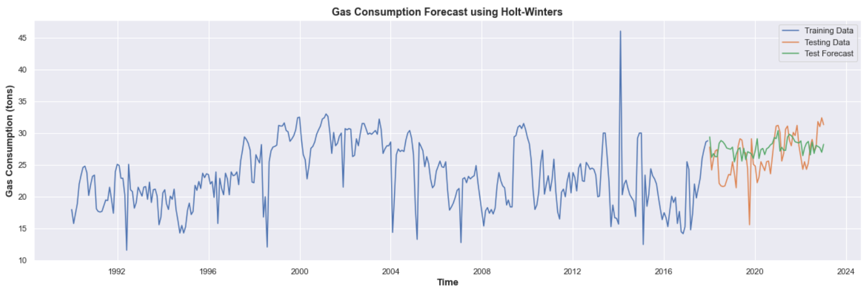
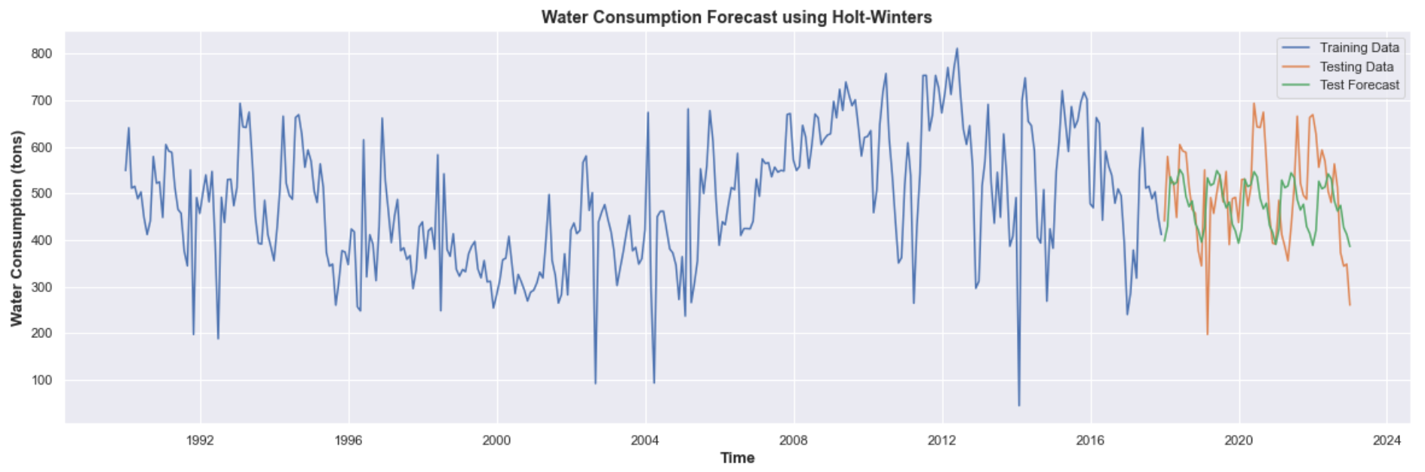
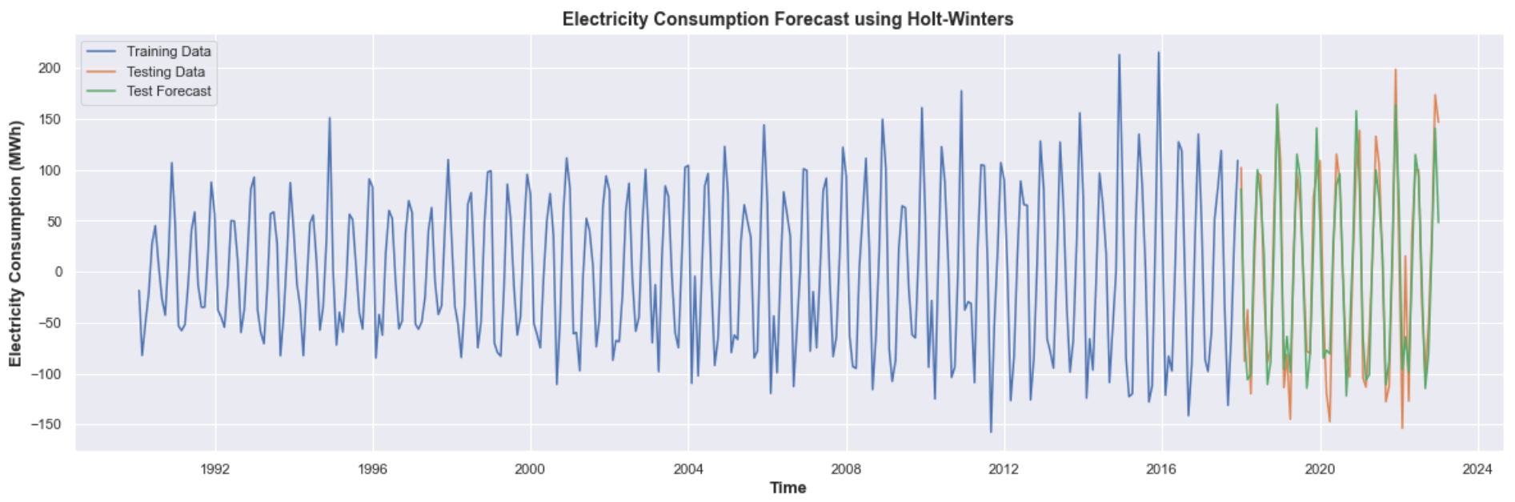
2. Seasonal Exponential Smoothing
For electricity consumption, the model actually forecasted the values pretty accurately as evident in the graph above.
The forecasted line not only shows similar fluctuating patterns, it also lies closely to the test data line.
For gas and water consumption, the model has only partially captured the underlying patterns and variations in the data and it is not fully accurate.
The forecasted line shows similar fluctuating patterns as shown by the test data line. However, there are some deviations with regards to the ranges of the two lines.

Slide 29
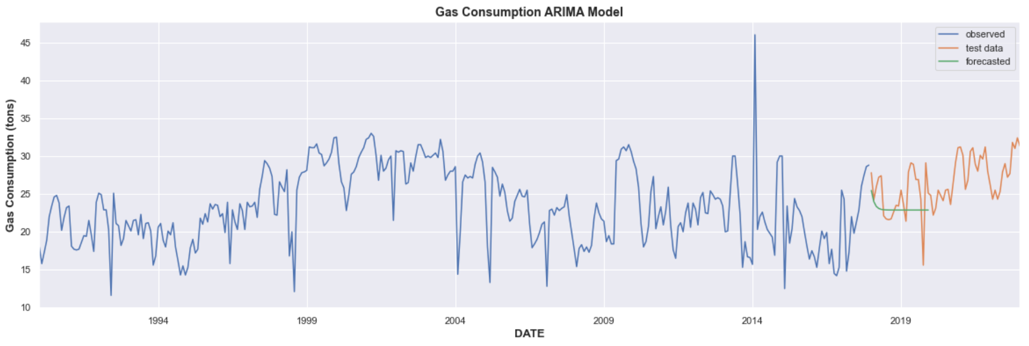
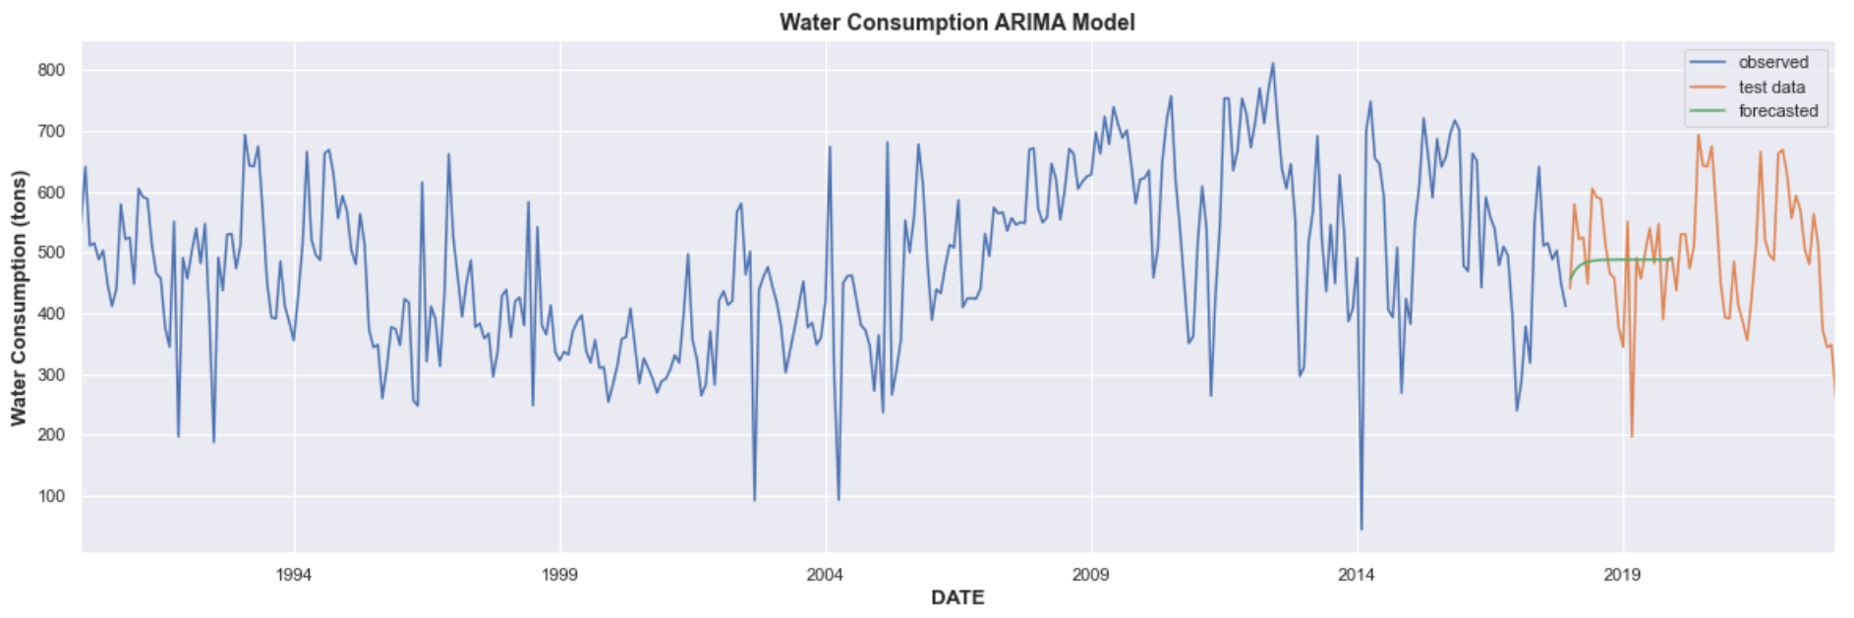
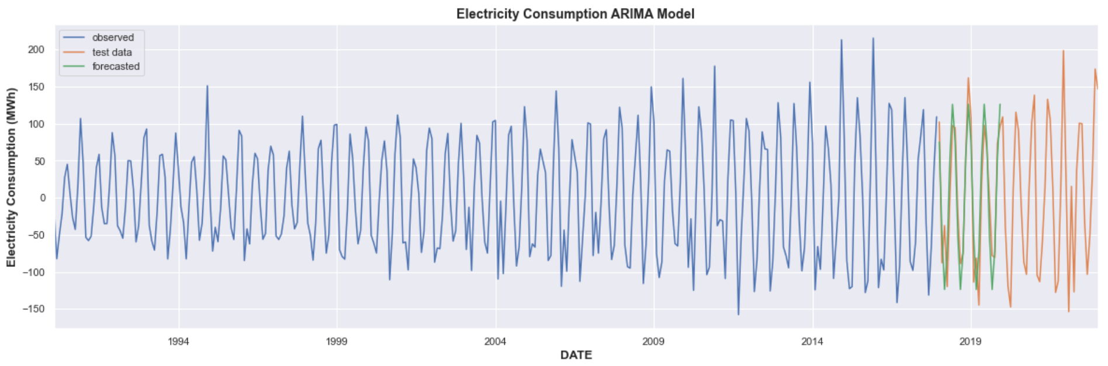
3. ARIMA Model
As shown in the graphs above, although the normal ARIMA model successfully forecasted electricity consumption values, it shows limited predictions for gas and water.
This shows that the normal ARIMA is not an ideal model for this analysis as:
It assumes that the relationship between past and future values of the time series is linear, as shown in the gas and water consumption plots.
It cannot handle seasonality very well.

Slide 30
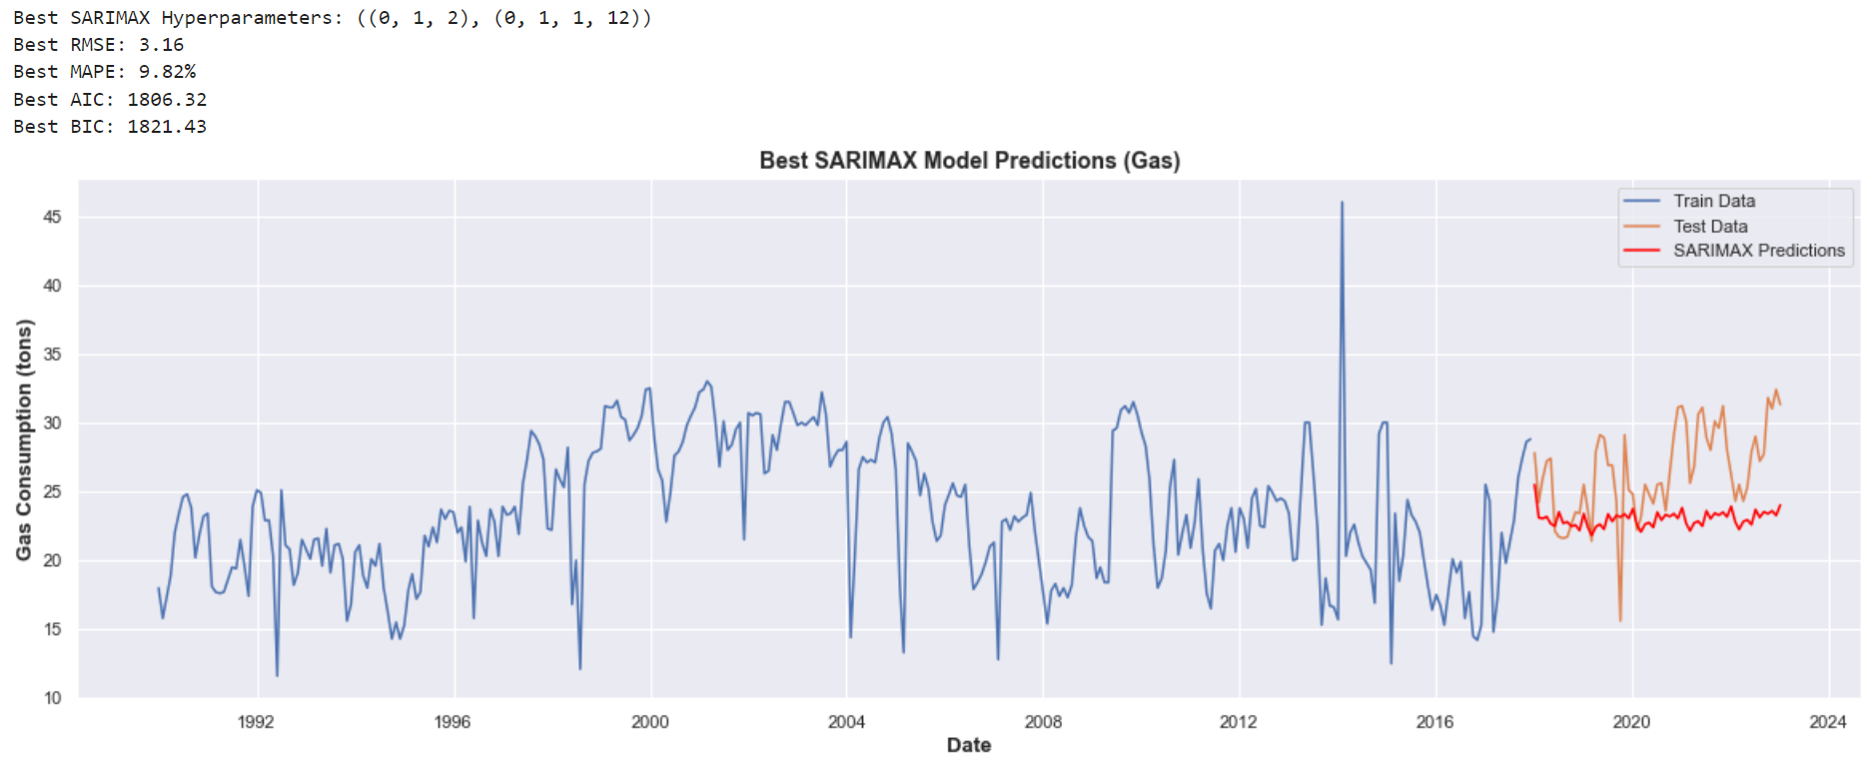
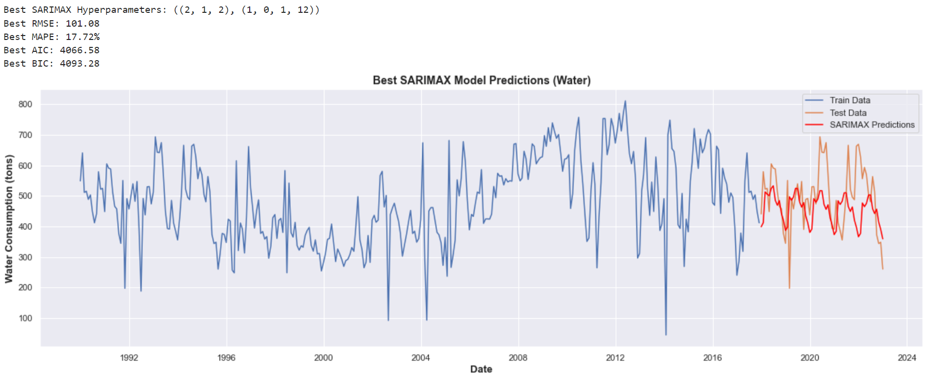
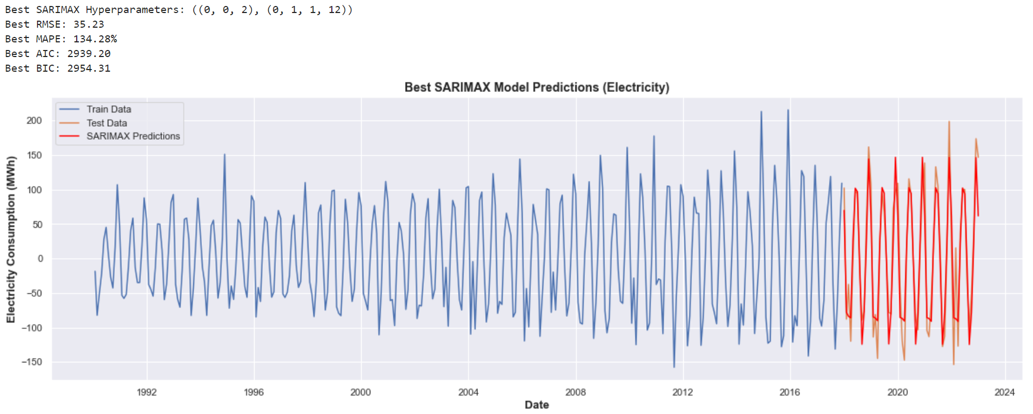
4. Seasonal ARIMA Model
As shown, the seasonal ARIMA is more accurate in forecasting future energy consumption values, as compared to the normal ARIMA model, including seasonality patterns.

Slide 31
05
Forecast Future

Slide 32
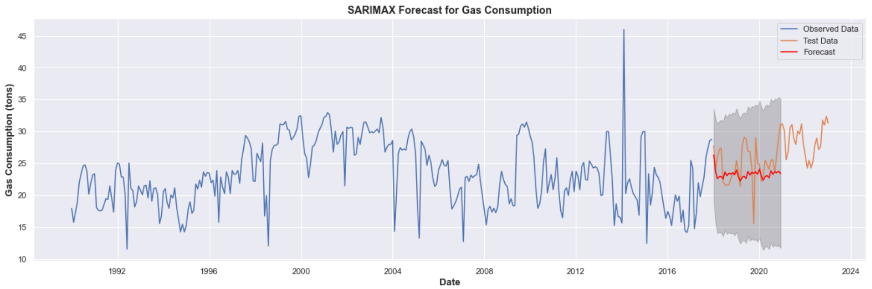
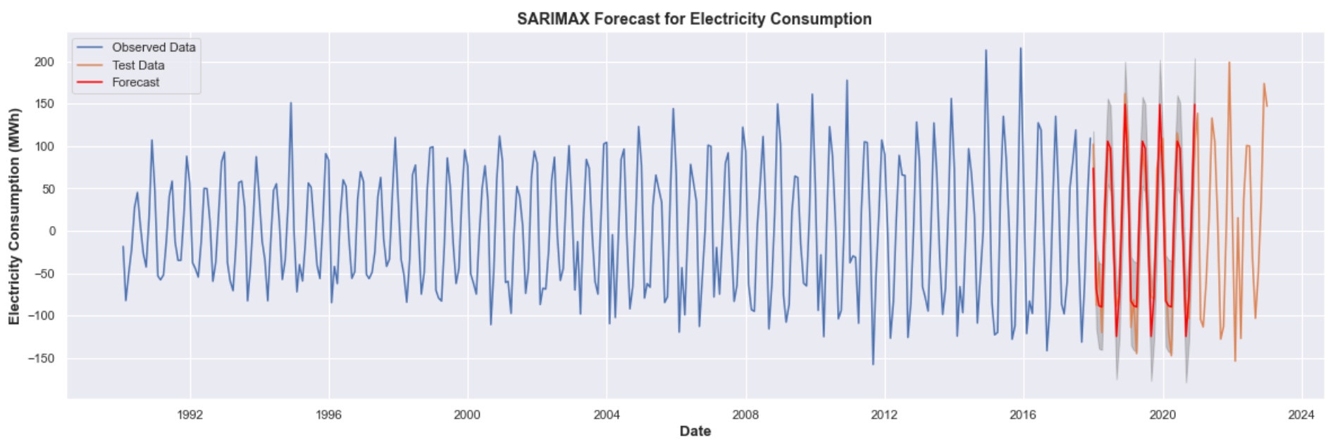
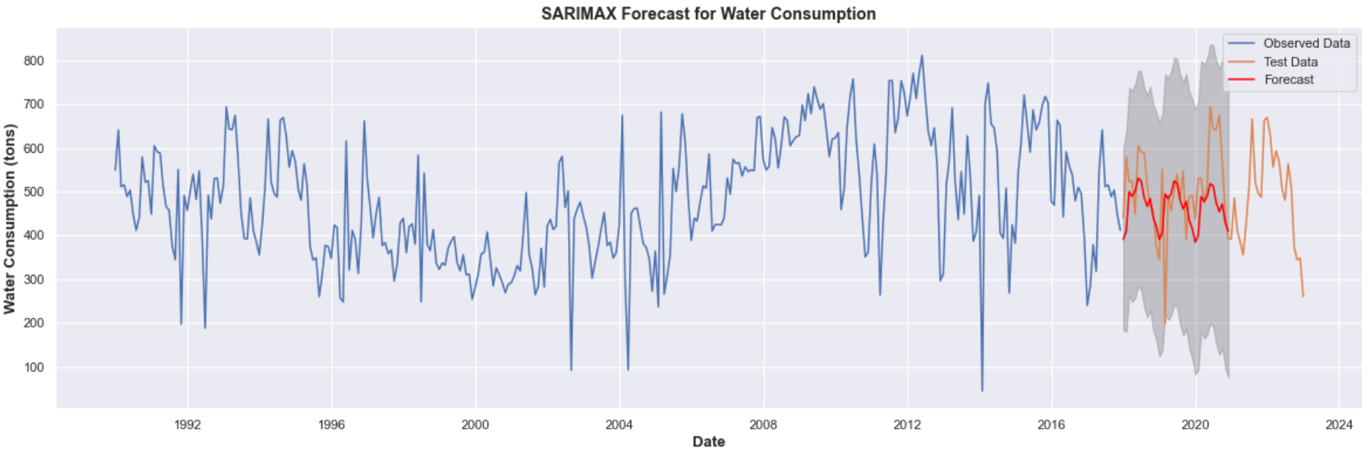
Making predictions for the next 3 years

Slide 33
Final Insights
I used ES and SES models to capture underlying trends and seasonality in the dataset.
I also used ARIMA and SARIMAX (includes seasonality), which consider both the historical values and their relationships to forecast future consumption.
The ARIMA model enabled me to capture the non-seasonal patterns present in the data, while the SARIMA model further incorporated the seasonality component, leading to more accurate predictions.
In conclusion, I learnt that different models have different limitations and strengths.
In this analysis, seasonal ES and seasonal ARIMA provided better results.
Seasonal ARIMA seems to be the best at forecasting future values, predicting fluctuations in water and electricity consumption values, while an increase in gas consumption values over time.

Slide 34
02
Unsupervised Learning (Part B)
Using the Customer dataset, perform customer segmentation and identify which group of customers
is the most valuable to the mall.

Slide 35
TABLE OF CONTENTS
01
02
03
04
05
06
EDA
DATA PRE-PROCESSING
FEATURE ENGINEERING
DIMENSION REDUCTION (PCA)
DATA VISUALIZATION
CLUSTERING ALGORITHMS
& EVALUATION

Slide 36
01
Exploratory Data Analysis (EDA)

Slide 37
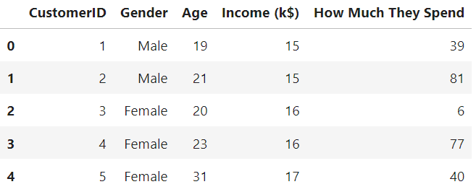
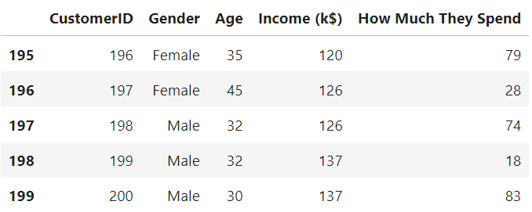

Exploratory Data Analysis (EDA)
All variables are numerical except for Gender.
112 females, 88 males.
200 rows and 5 columns.
No null, missing, or duplicated values.
Presence of outlier in Income (k$) column (anomaly).
Overall, data seems to follow a consistent distribution.
There are 200 distinct customers in the Customer dataset.
The average age of the customers is 39 years old, with the youngest being 18 and oldest being 70.
The income gap is decent, where the standard deviation is 61k dollars.
The average amount customers spend is around 50k dollars.

Slide 38
02
Data Pre-Processing

Slide 39

Data Pre-Processing
Handling categorical variables
Generally better to avoid label encoding as may unnecessarily introduce ordinal relationships that do not exist in the data.
Clustering algorithms such as K-means, are sensitive to the scale and magnitude of the features. Converting will affect model's performance and lead to bias and inaccurate results.
May also create a higher-dimensional feature space, possibly negatively impacting the performance of clustering algorithms sensitive to dimensionality.
Furthermore, upon feature selection, we will find out if Gender is truly relevant for customer segmentation. So for now, we will not change anything.
Renamed columns for better understanding

Slide 40
03
Feature Engineering

Slide 41

Creating New Features
New feature 1: Spending Ratio
By calculating the ratio of spendings to income for each customer, it can help identify customers who allocate a higher proportion of their income towards shopping, indicating higher value to the mall.
Spending_Ratio = Spendings ($k) / Income ($k)
New feature 2: Spending Score
By calculating the Z-Score for each customer's spending, can help measure how a customer's spending compares to the average spending of all the customers, helping to identify high spenders and low spenders to the overall customer base.
The Z-Score represents how many standard deviations the customer's spending is from the mean spending.
Positive z-scores indicate that the customer spends more than the average, while negative z-scores indicate lower spending compared to the average.

Slide 42


Feature Selection
Removed non-informative columns:
CustomerID is not relevant and cannot contribute useful insights for clustering. (can tell how many customers based on index as well)
Removed Gender column:
No clear relationship between Gender and other features.

Slide 43


Feature Scaling: Standardization
The medians of all features are vastly different.
Different distributions -> different IQR.
Different ranges.
Presence of outliers.
Transformed the features of a dataset to have a mean of 0 and a standard deviation of 1.
Closer ranges, distributions, medians, and means.
The numerical variables in the customer dataset all now on a similar scale, and are suitable for ML algorithms.

Slide 44
04
Dimension Reduction

Slide 45

Dimension Reduction: PCA
PC 1:
Spendings, Spending_Ratio, and Spending_Score exhibit high positive loadings, implying that customers with higher spending and spending ratios are positively correlated with this component.
PC 2:
Significance of Income in positively influencing the component.
PC 3:
Emphasizes the impact of Age in a negative direction, suggesting that older customers contribute more to this component.
These features are likely important drivers of spending behavior and could be retained for segmentation. (feature selection)

Slide 46
05
Data Visualization

Slide 47

Visualize Overall Relationships
Spendings and Spending_Ratio exhibit a strong positive correlation. Furthermore, both of these variables also show a positive correlation with Spending_Score, implying that customers with greater spending and spending ratios tend to receive higher spending scores.
The correlation between Age and the financial variables appears relatively weak.
Interestingly, Income ($k) demonstrates a moderate positive correlation with Spending_Score, suggesting that customers with higher income tend to receive higher spending scores. This aligns with the expectation that customers with higher income levels might engage in more spending activities, contributing positively to their spending scores.

Slide 48


Visualize Distributions
Positively-skewed (right-skewed).
Popularity:
Majority of the customers visiting the mall fall into younger age groups.
Marketing opportunities:
The shopping mall can think of ways to satisfy the current popularity of the younger age groups, who have longer customer lifetime, to maintain its productivity.
It can also think of more ways to attract the older age groups, who may have higher purchasing power, to further increase its productivity.
The histogram of distribution of customers' income is positively-skewed (right-skewed).
This indicates that majority of the customers' incomes fall between 20k dollars to 80k dollars, while a minority have incomes greater that $80k.

Slide 49
06
Clustering Algorithms

Slide 50


K-means Algorithm
As the number of clusters increases from 1 to 6, there is a generally smooth drop, however, as it continues to increase from 6, a slight elbow can be observed.
As such, it is evident that the number of clusters=6 is the most suitable choice.
To gain more accuracy on the number of clusters to be used, let's use silhouette scores to see if the results support the above.
Based on the results above, the highest/best silhouette scores are 0.448 and 0.440 for n_clusters equals to 6 and 7 respectively.
Choice of cluster: 6.

Slide 51





GMM Algorithm
Gaussian Mixture Model (GMM) models the distribution of data points in a multi-dimensional space.
It is particularly useful for clustering data points when the underlying data distribution is not linear or well-separated.
Based on the comparison, 5 clusters seem to yield the best results.

Slide 52




Hierarchical Algorithm
Hierarchical clustering groups similar data points into clusters based on their pairwise similarities or distances.
It creates a hierarchical structure of clusters, where clusters can be further divided into smaller subclusters.
6 clusters seem to be the most suitable. (7 has a better score but it is too complex)

Slide 53
Final Insights
Best number of clusters seem to be 5 or 6.
5 to 6 different clusters:
Low income and low spendings
High income and low spendings
Low income and high spendings
High income and high spendings
Average income and average spendings
Overlap in average income and average spending clusters may indicate that shopping mall have higher demand of this group of customers, hence can think of ways to attract them.

Slide 54
Thank you!

